Slide 1


Chapter 7 Nursing Management of Pain During Labor and Birth
Niomi Quinteros, BNS, RN

Slide 2

Types of Prenatal Classes
Childbirth
Exercise
Gestational Diabetes Mellitus
Sibling
Grandparent
Breastfeeding
Infant Care
Vaginal Birth After Cesarean (VBAC)

Slide 3
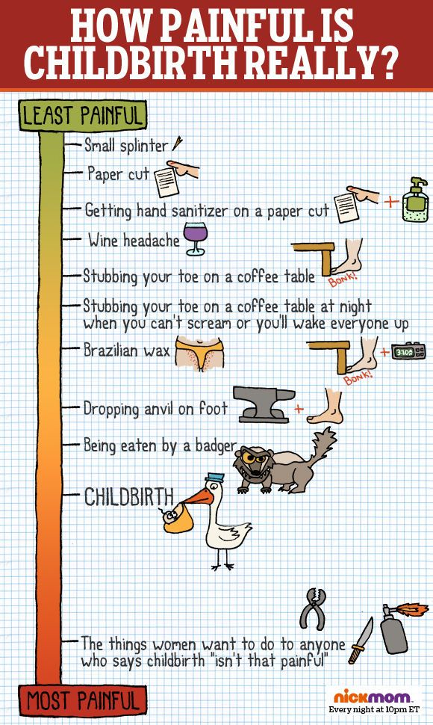
Childbirth Pain
Part of normal birth process
Woman has several months to prepare for pain management
Self-limiting and rapidly declines after birth
May cause woman to feel vulnerable
Motivates to assume different positions to assist fetus to descend

Slide 4
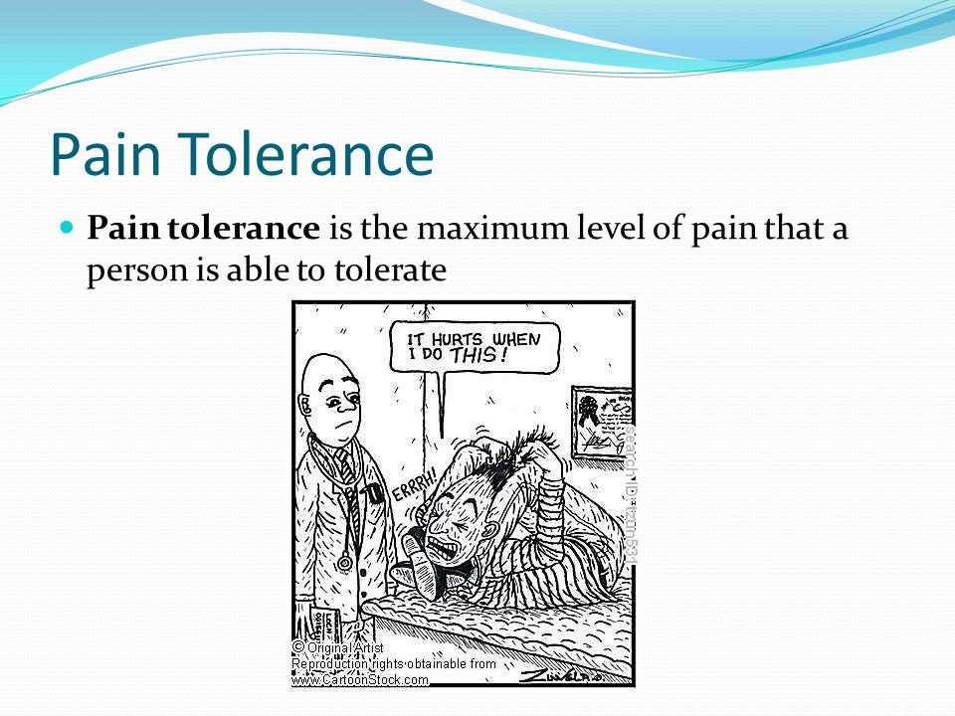
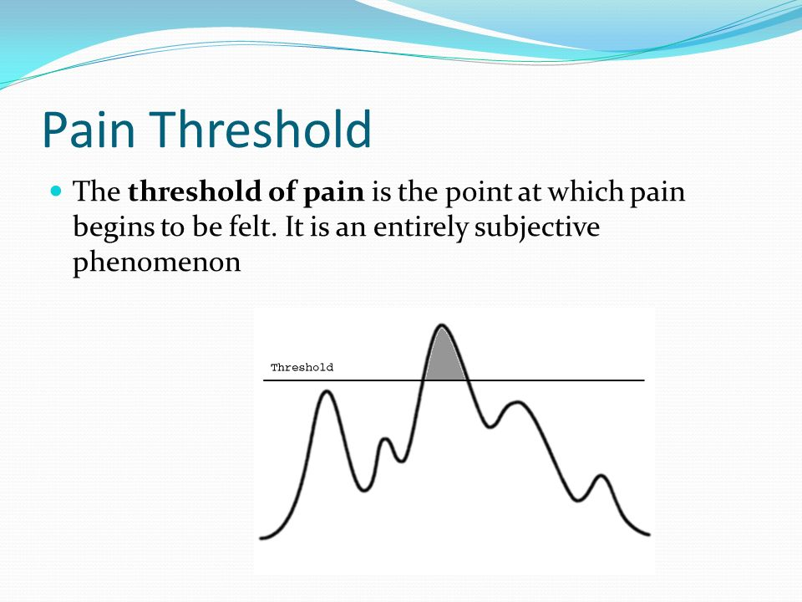
Sources of Pain During Labor
Dilation and stretching of cervix
Reduced uterine blood supply during contractions
Pressure of fetus on pelvic structures
Stretching of vagina and perineum

Slide 5
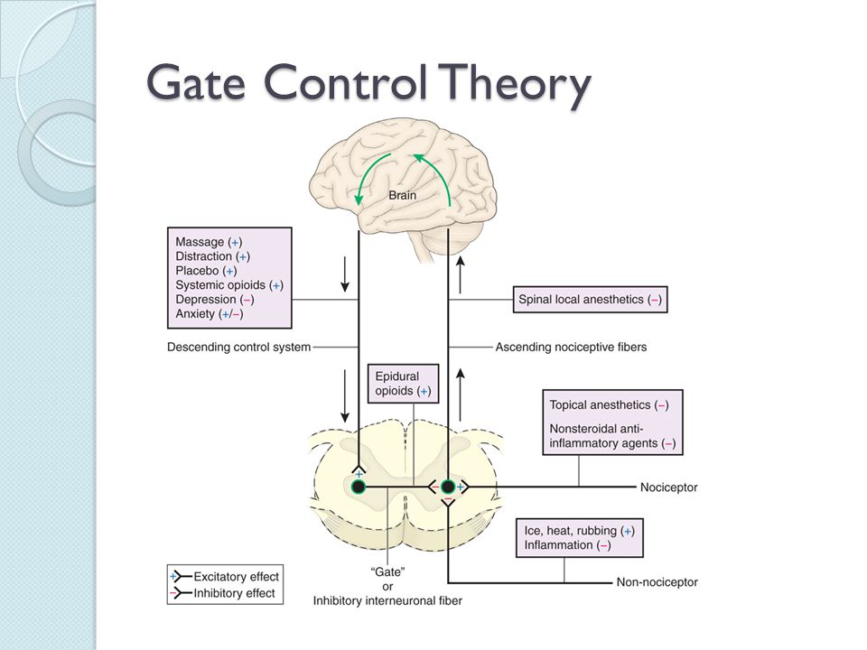
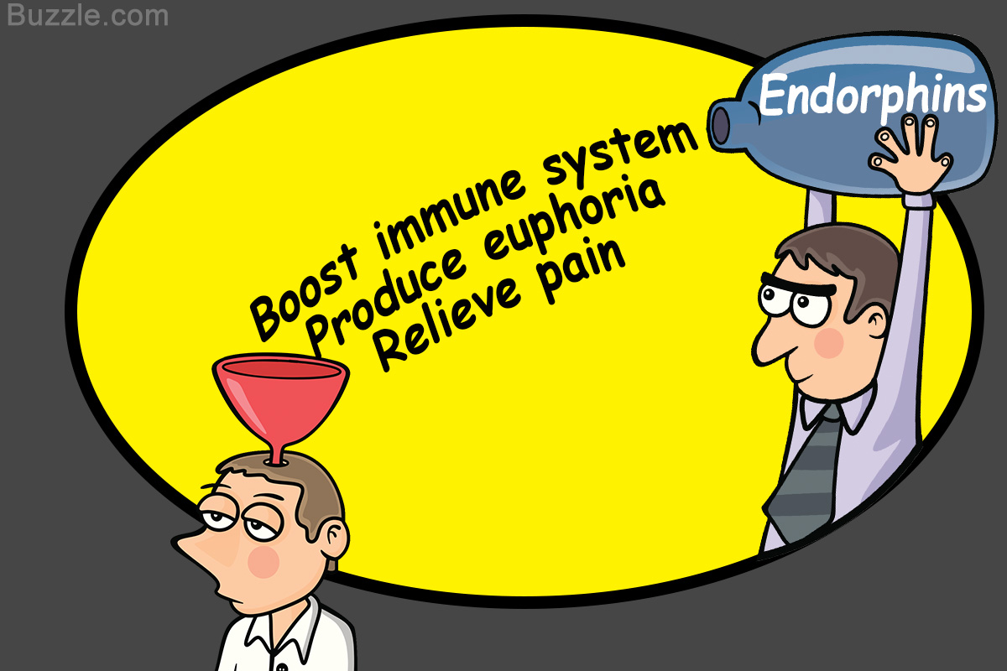
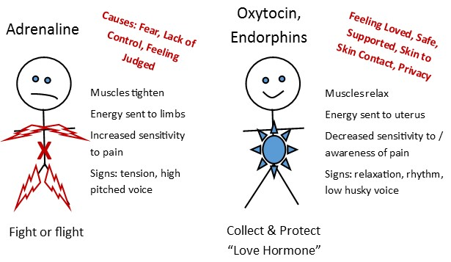
During labor, stimulated by exercise, light massage, and touch.
Box 7-1

Slide 6

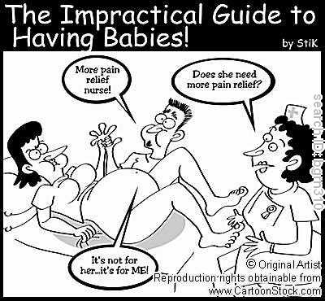
Sources of Pain
Maternal
Cervical readiness
Pelvis
Labor intensity
Fatigue
Fetal Presentation & Position
Interventions
Psychosocial Factors

Slide 7

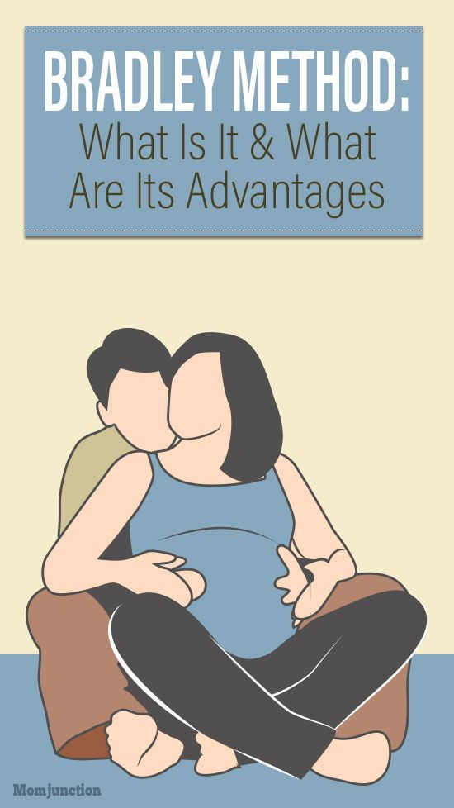
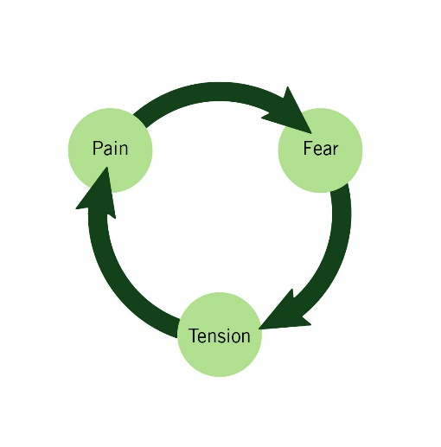
Childbirth Preparation Methods
Dick Read Method
Fear-tension-pain
Relaxation to interrupt cycle
Bradley Method
Husband coached birth
Abdominal breathing and relaxation techniques
Lamaze Method
Bases of most CB classes in US
Relaxation and breathing

Slide 8
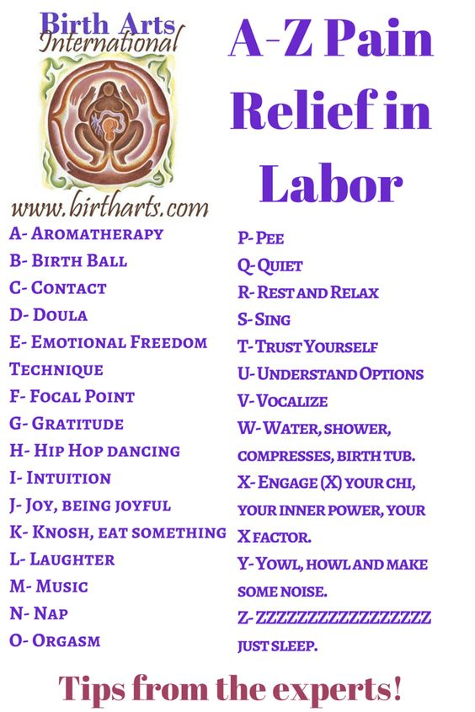
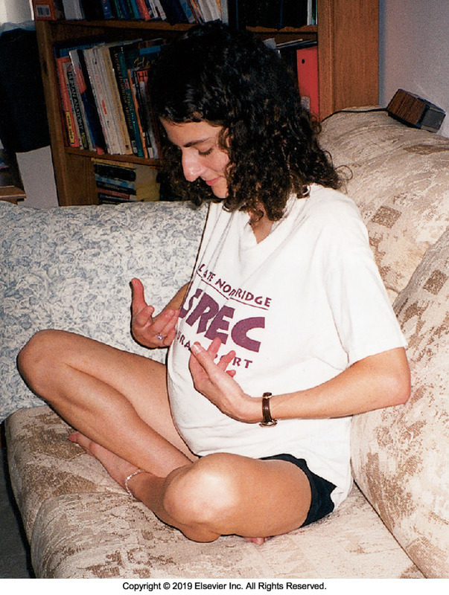
Non-Pharmacologic
Advantages
No harm
Do not slow labor
Carry no risk for allergy
No risk of adverse effects
Limitations
Prior rehearsal needed

Slide 9
NON-PHARMACOLOGICAL TECHNIQUES
breathing
POSITIONING
Diversion
&
Distraction
Skin stimulation
relaxation

Slide 10
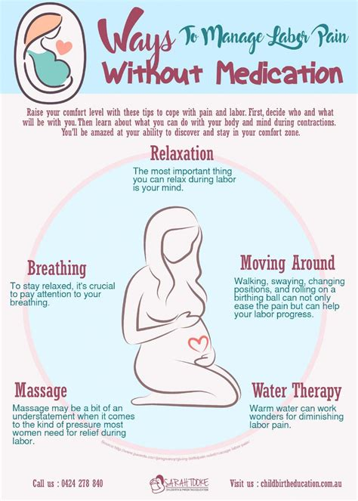
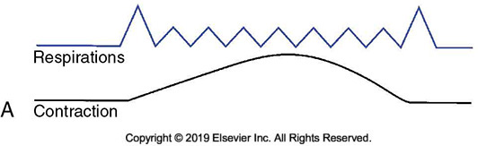
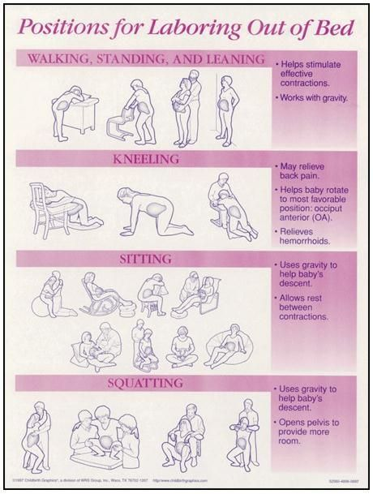
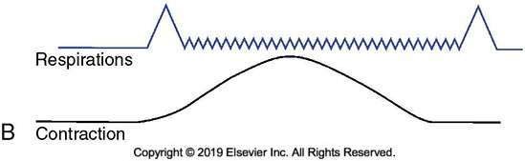
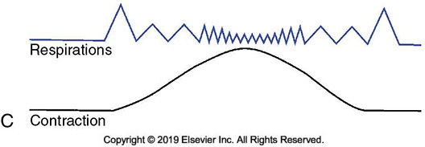
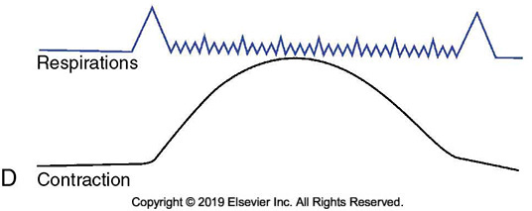

Slide 11
Pharmacologic Pain Management
Opioids
Small doses
Helps with coping not COMPLETE pain relief
Avoided within 1 hr of birth
Naloxone is narcotic antagonist
Reverses effects
Pain will return
Epidural
Procedure
Limitations
Adverse effects
Hypotension
SAFETY!!!
Check movement and sensation before ambulation

Slide 12
Pharmacologic Pain Management
Local/Pudendal Block
Injected in the perineal area or pudendal nerve
Adverse Effects
Check allergies
Vaginal hematoma
Abscess
General Anesthesia
Emergency CS or CS birth if epidural or spinal block doesn’t work
Adverse Effects
Aspiration

Slide 13
Nursing Care Plan – Woman Needing Pain Management During Labor
Safety Alert p. 177

